Slide 1
Part 2: long distance signaling and myelin

Slide 2
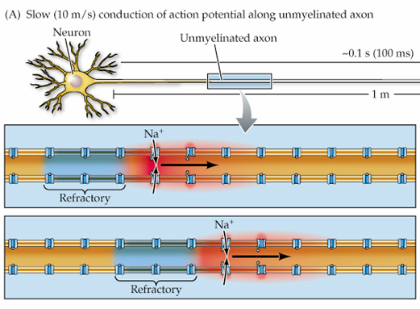
Movement of the action potential
Action potentials typically move away from the cell body, towards the axon terminals.
  Refractory periods help
An action potential in one segment of the axon triggers an action potential in the next segment due to passive current flow.

Slide 3
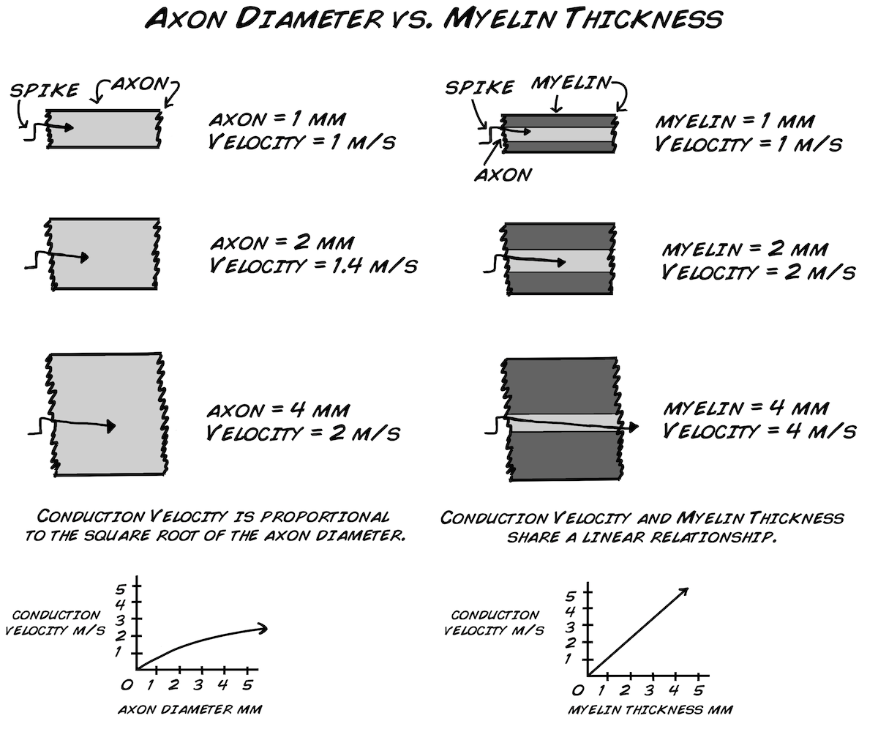
Speeding up Conduction velocity
Two mechanisms:
  Increase the diameter of the axon.
  Myelin!

Slide 4
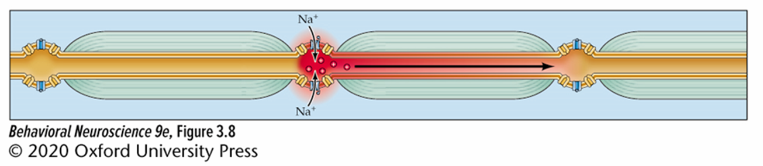
Myelin
Rich in lipids
  High resistance
    Keeps passive charge from leaking out
  Low capacitance
    Does not store charge well

Slide 5
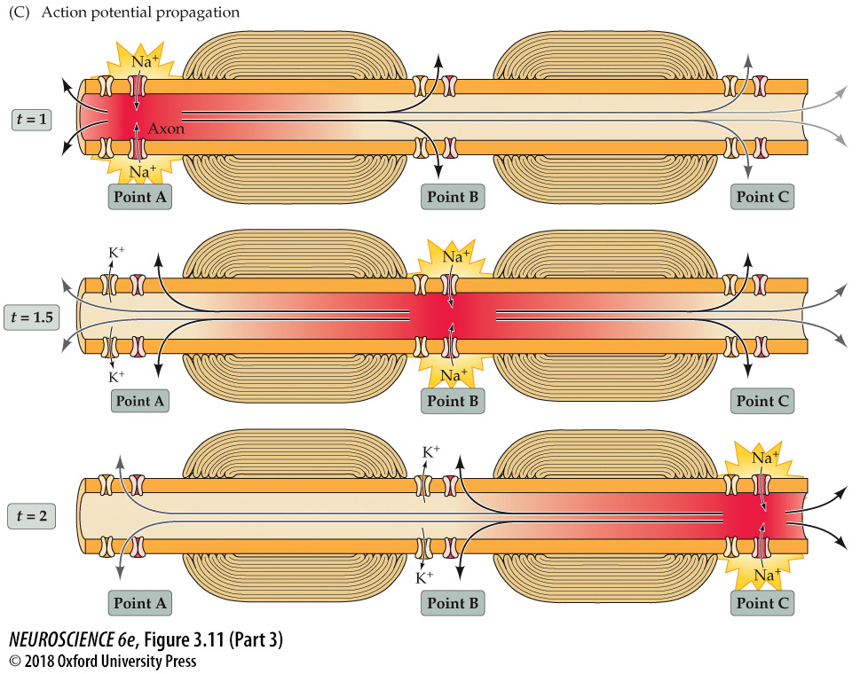
Saltatory Conduction
Action potentials “leap” from one node of Ranvier to the next.
  Voltage gated Na⁺ and K⁺ channels are localized to nodes of Ranvier
Saves time and energy.

Slide 6
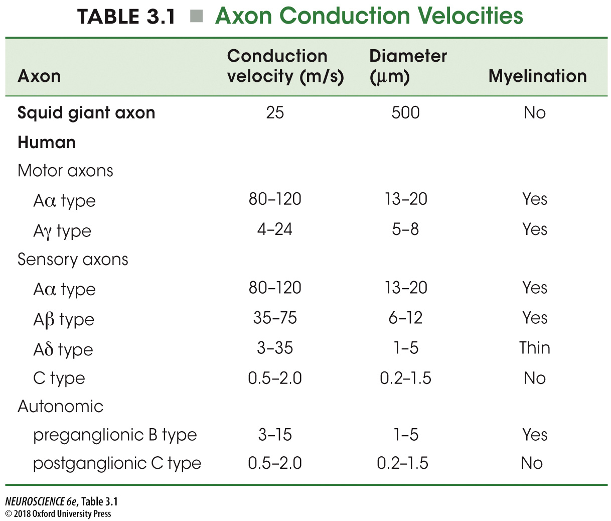

Slide 7
Myelin Associated Disorders
Demyelination
  Multiple Sclerosis
  Guillain-Barre syndrome
  Viral-induced (e.g., Theiler’s Virus, Canine Distemper Virus )
Developmental Disorders leading to hypomyelination or dysmyelination

Slide 8
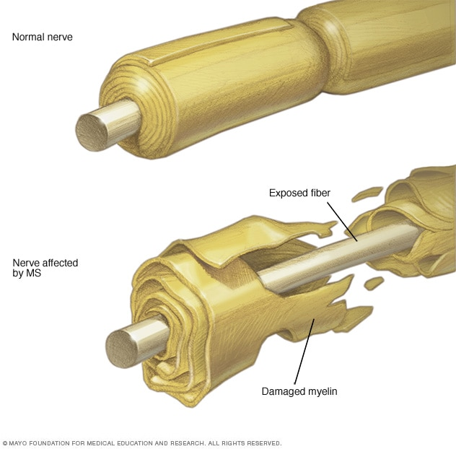
Multiple Sclerosis (MS)
A disabling disease of the nervous system resulting from a disruption of neural communication.
Involves an autoimmune-mediated process in which myelin is damaged.
Typical onset of symptoms between 20-40 years of age.
Affects over 2 million people worldwide

Slide 9
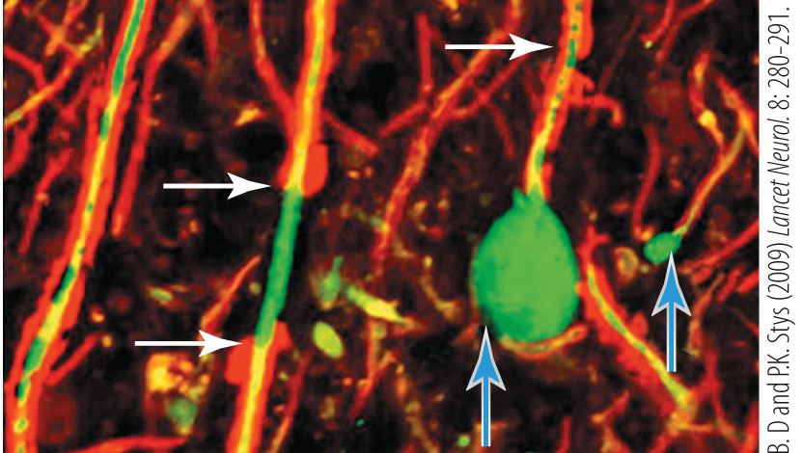

Slide 10
3 Main types of MS
Relapsing remitting
  Periods of attack (relapse) followed by remittance (partial or complete recovery)
  Most common type
Primary Progressive
  Once symptoms start they continuously worsen over time
  No relapse or remittance
Secondary Progressive
  Can develop after a period of RRMS where symptoms become more progressive
  May still experience periods of stability

Slide 11
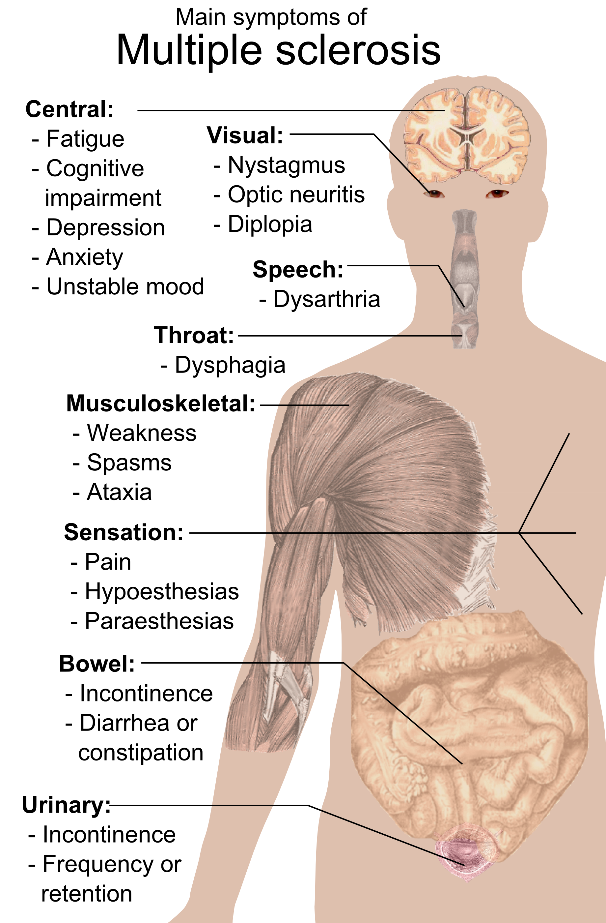
Possible symptoms
Symptoms are related to the location of the affected neurons.

Slide 12
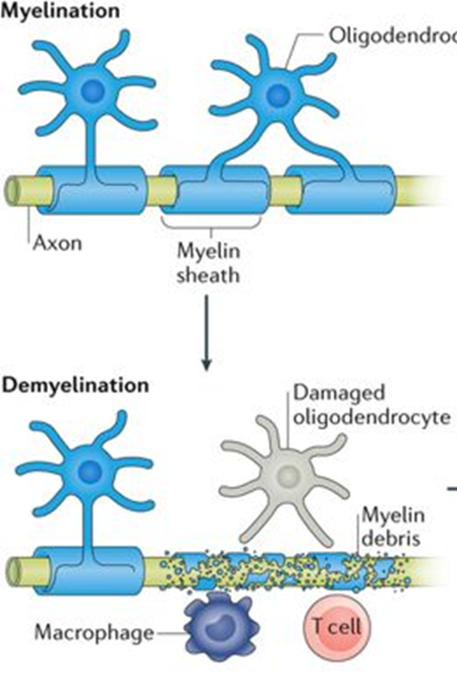
What causes MS?
Hypotheses:
Autoimmune Disease
Viral Infection
Genetic susceptibility
Persistent infection

